Slide 1


Hackathon 2023

Slide 2
Comma Chameleons

Slide 3

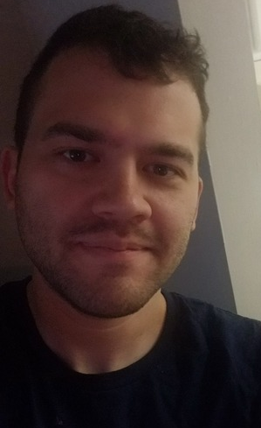
Team Introductions and Pictures
Dean Chanter John Harris

Slide 4
Can the government unlock the value within unstructured text, driving better decision-making and improved public interactions, all while ensuring data integrity?

Slide 5
The Challenge:
Data Diversity: The government manages vast datasets from varied sources, and mixed-formats with little to no standardization complicating data navigation. Valuable insights often buried within the volume and complexity.
Access Challenges: Timely retrieval of the most relevant data needs to be improved while ensuring data security access is still paramount
Public Interface Demands: Achieving accuracy and consistency during public interactions is foundational to building trust, ensuring efficiency, adhering to legal mandates, safeguarding the public, and managing reputation.
Manual Analysis Limits: Traditional manual methods are costly, time-consuming, have inconsistent results, and are subject to human error and need more adaptability to rapid changes.

Slide 6
The Solution: RAG Models for Text Summarization
RAG Defined: Retrieval-augmented generation seamlessly merges efficient data retrieval with advanced text-generative capabilities.
Efficient Data Management: RAG swiftly navigates vast datasets, bringing forward the most pertinent information for a vast array of applications such as regulation summarization, public communications, or fraud detection.
Elevated Public Services: RAG meets public queries with accurate, context-sensitive responses, enhancing user satisfaction using natural language.
Assured Consistency: Automation ensures fewer errors and consistent quality in information dissemination.
Cost Benefits: While there's initial investment, RAG can offer significant long-term operational savings.
Adaptable Framework: RAG models can be updated as policies evolve or new data surfaces, ensuring up-to-date responses.
Enhanced Data Containment: Bring your own data and LLM Integrated systems reduce data fragmentation while bolstering security measures and unauthorized access.

Slide 7
Source Code
GitHub Repo
https://github.com/OctoConsulting/comma-chameleons.git
All Final Code is in the Main Branch but requires GPUs to run encoding so either need a ”private GPU” or WatsonX
WatsonX Project
https://dataplatform.cloud.ibm.com/projects/0ec8f431-3b27-41a3-a540-98d7f62ca1ad/assets?context=wx
Test_Rag Notebook Shows E2E rag
Collab Notebook To demo the Front End
https://colab.research.google.com/drive/1e4hayOjN1oGNK6lLdPpPIOqB36rdnGXP?usp=sharing

Slide 8
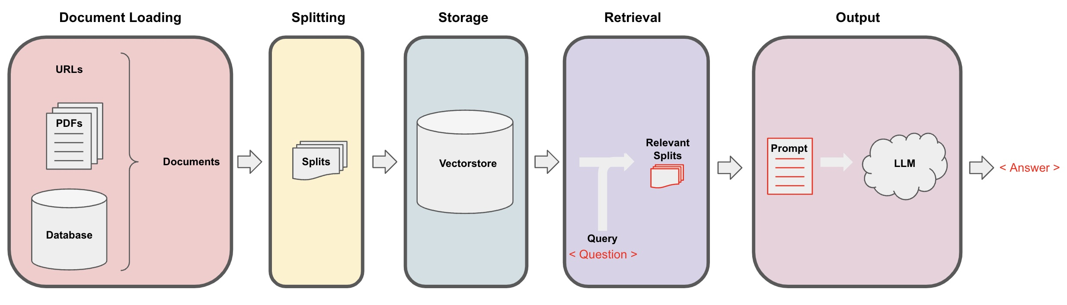
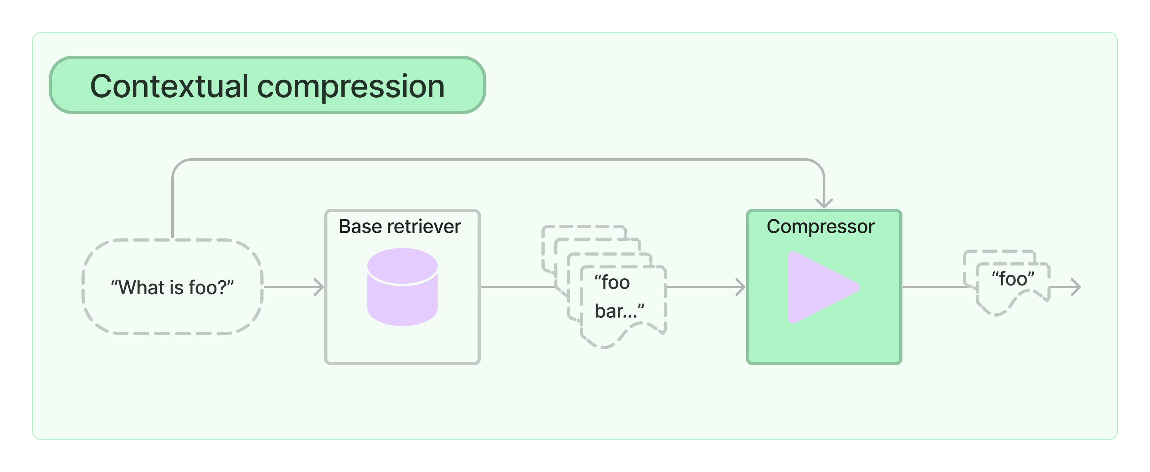

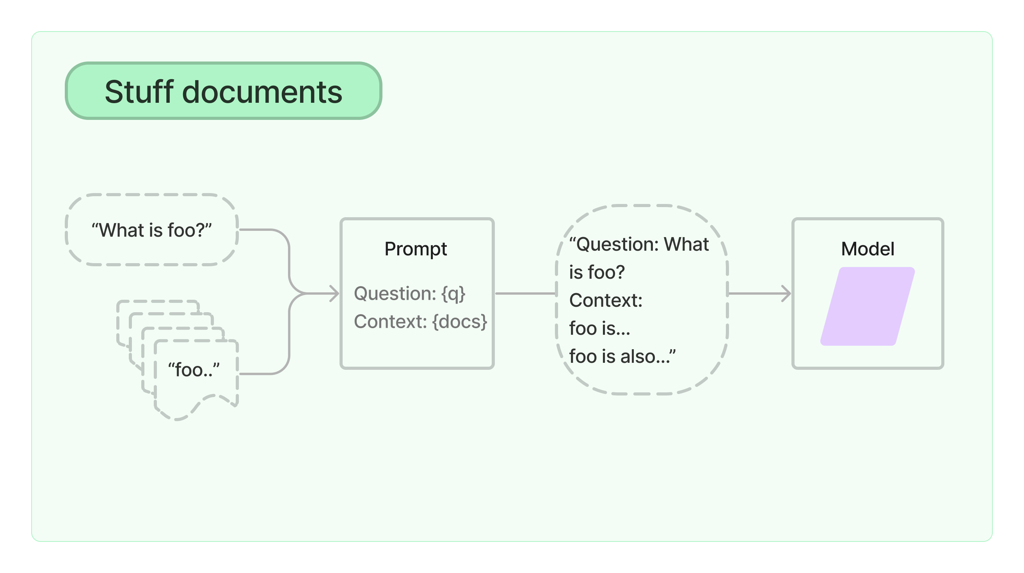
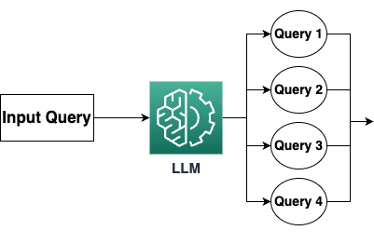
RAG Architecture Diagram
Embedding Model
Embedding Model

Slide 9


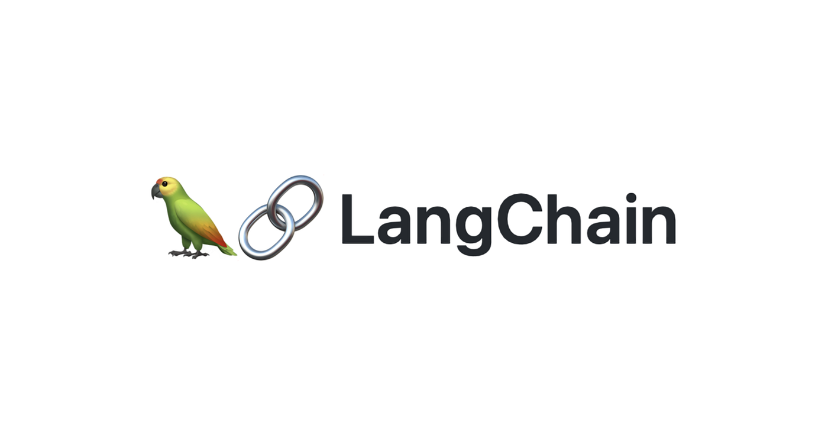

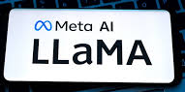


Tools & Technologies Used

Slide 10
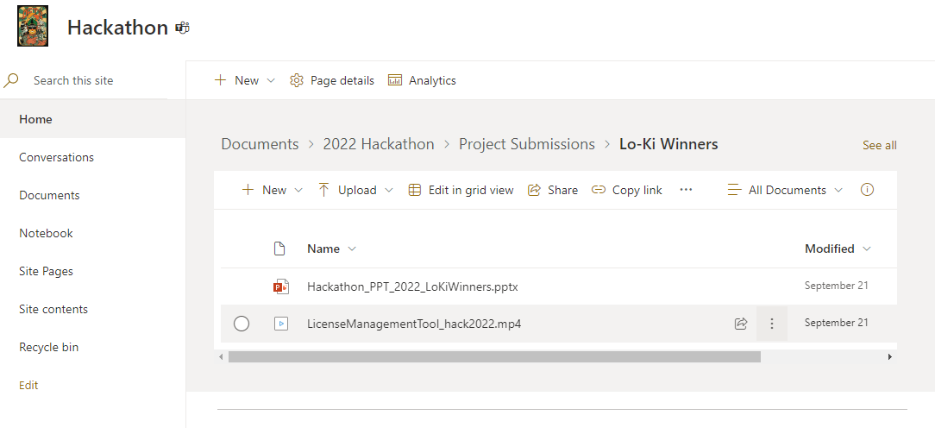
Documentation
Create your project submission folder here with your project name
Use this folder to upload your documents & video submission
Example:

Slide 11
Video Submission
Video Rules
Video must be uploaded to your documentation folder
Video must be in HD (1080) or 4k and shot horizontally
Video must be no longer than 2 – 6 mins in length and in mp4 format
Video naming format (Hack Name_hack2022)
Video Outline and Timeline (6 mins max)
Introduce the team- <1 min
Introduce the problem/challenge that you are solving- <1 min
Demonstrate your solution and tell us how it solves the problem/challenge- <8 min
Other considerations
Sell your idea! The idea is what holds value.
Why should we invest in your solution?
Your video submission will be judged on
• Scalability – Can your hack accommodate expansion without compromising efficiency?
• Business Value – Does your hack align with what our customers are asking for?
• Innovation – Did you find a new or unique way to use technology to solve an existing problem?
• Polish – Was the final submission package professional, organized, and well presented?
• Wow Factor – Did your hack make a strong, positive impression on the judges?

Slide 12
GOOD LUCK!

